Slide 1


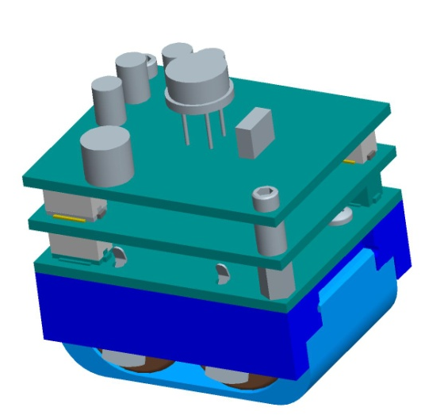
Design of a GPS Capture and Process System for Wireless Networks
Eidy C. Herrera Jacob J. Johns
Hartman D. Rector
Cory Shirts
Kerry R. Wiser

Slide 2
Outline
“Introduction to GPS Tracking System”
Cory Shirts
“Prototype Design and Construction”
Kerry R. Wiser
“Embedded Programming”
Hartman D. Rector
“Transferring GPS Data to a PC”
Jacob J. Johns
“Processing GPS Data”
Eidy C. Herrera

Slide 3
Introduction to GPS Tracking System
Cory Shirts
Notes:
I would like to welcome all of you to our presentation about a GPS tracking system.
Our team included 5 students from the Electrical and Computer Engineering department at the university of Utah, (say each by name).

Slide 4
Introduction
GPS tracking system
Design requirements
Design modifications
Component overview
Notes:
My portion of the presentation will give an overview of the project and introduce its main components. I will first introduce the reasoning behind a GPS tracking system. I will then discuss the design requirements along with the design that the team from the previous year came up with. I will discuss the design that we decided on, there were some modifications that we discovered needed to be introduced. Lastly, I will give a brief introduction to each part of the project.

Slide 5
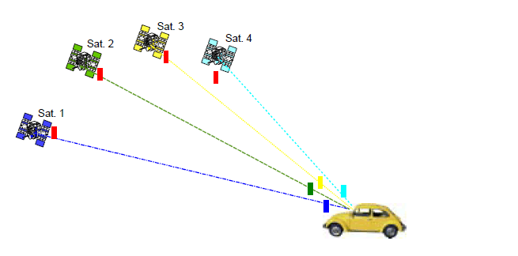
GPS Tracking System
GPS (Global Positioning System)
Consists of constellation of satellites orbiting the earth
Signals from 4 satellites required to determine position
Notes:
Now one may ask, what is GPS? And how does it work? GPS stands for Global Positioning System, it consists of a constellation of satellites, 30 of them was the figure that I found, orbiting the earth. One of the features of this constellation is that at any point on the earth, there are guaranteed to be at least 4 satellites that a receiver would be able to get signals from. This is the number of satellites a GPS receiver needs to calculate its position on the earth.

Slide 6
GPS Tracking System
Typical GPS solution
Cold start (no data) needs about 40s of data
Internal processing
Applications for location tracking in real time
Notes:
In order for a GPS receiver to calculate one position, it needs 40 seconds of data. The data is processed internally, that is processed with the same machine that gathered the data. After this, the receiver’s position can be tracked in real time, showing exactly where it is as it moves. This allows applications to calculate a position and be accurate within a few meters, and with the more advanced ones, within centimeters.

Slide 7
GPS Tracking System
Drawbacks of typical solution
Power consumption
Data storage
Not for portable devices
Notes:
However, there are parts of this solution that make that make it less compatible with other applications. For example, what if you wanted to track a position over time with a portable device. The large amount of data would require larger amounts of space, and continuously processing that data would require the resources of a processor, which when it is always on would consume large amounts of power. These things make this solution for smaller devices less feasable.

Slide 8
Portable GPS Tracking
Samples
taken periodically
taken when needed (detected motion)
contain only essential data
Data transferred to PC
Post-processing, web service do the rest
Notes:
To help with this, there is a concept of a portable GPS tracking device. To save on power, short GPS samples are taken periodically and only when needed (such as when the device is moved). The samples are later transferred to a PC, where post-processing and a web service fill in the gaps to provide the data needed to calculate a position.
One example of a product that this project was inspired by was from a company called GeoTate. Their device had the ability to be plugged into a camera, and for each picture that was taken, a .2 second long GPS sample was also taken by this device. Later, when the memory was plugged into a computer, an application would lookup the rest of the needed data on an online database that stores GPS satellite info using the collected samples. This would allow for the application to calculate the position on earth where each picture was taken.

Slide 9
Design Requirements
Low power consumption
Run off 2 CR2 batteries (3.3 Volts)
Last for two weeks
Compatibility with Sandia Stack
Size constraints
Interoperability with other
devices in the stack
Sandia Stack
0.3”
0.6”
1.25”
1.5”
Notes:
For this project, we needed to design a device for Sandia Labs that does something similar. It needed to run off of CR2 batteries, commonly used in cameras. We also had some size constraints. It needed to be compatible with the Sandia Stack, a device that is able to stack different chips and be stored for 2 weeks, running each of the devices. An eventual application of our chip would be to plug in our device to the Sandia Stack and then ship it with some cargo, it would then track the whereabouts of the cargo while it was being shipped.

Slide 10
Previous Design
Design from previous team
Processor with Low Power Modes (LPM)
Accelerometer to trigger wakeup
Small flash chip to store small samples
SiGE GPS receiver

Slide 11
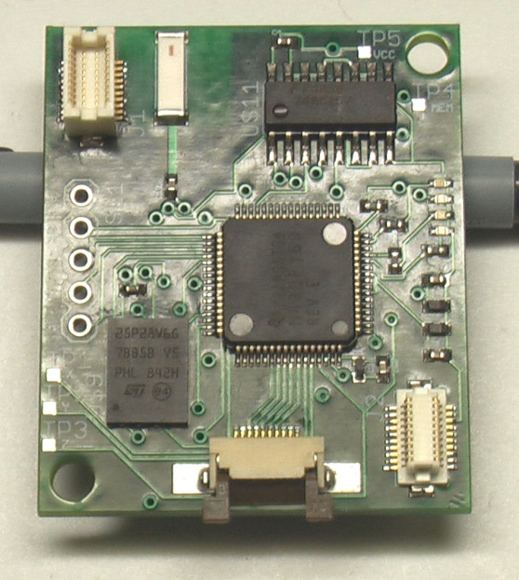
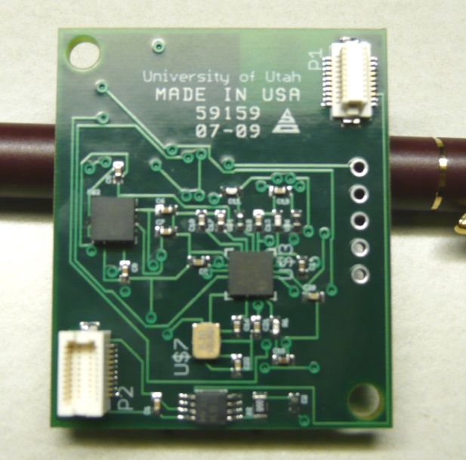
Previous Design
Top Side
Bottom Side

Slide 12
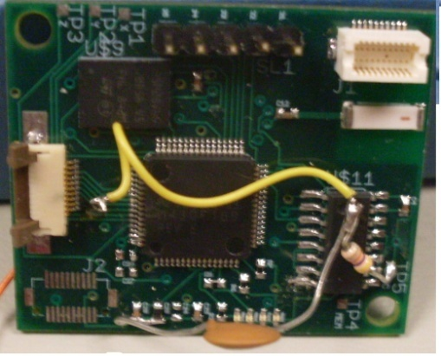
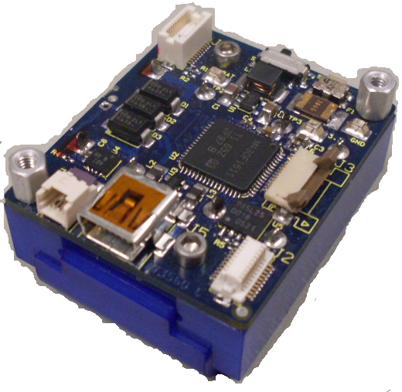
Design Requirements
Changes needed
Broken Components
Difficult to test
Processor was slow
Flash memory was small
From 08-09 Team
Sandia Stack

Slide 13
Design Modifications
Our approach
New, faster low power processor
Bigger flash chips
Newer accelerometer model
Use testable prototypes for development
Sandia Stack

Slide 14
Prototype Design (Kerry)
Eagle CAD for maintaining schematics and manufacturing parts
Some parts were bought
Assembled some, had some made
List of Prototypes
Accelerometer
Flash memory
SiGE GNSS antenna
Multiplexers

Slide 15
Programming Overview
Setup
Get Info on bad flash blocks if we don’t already have it
Setup ADC for Accelerometer
Setup external wake-up pin
Main Loop
Enable wake-up pin
Go into LPM3 mode to save power
Interrupt once per second to check for movement
Disable SiGE
Turn off ADC, initialize flash, and enable SiGE
Exit LPM3 if movement or wakeup signal is detected

Slide 16
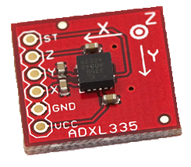
Programming (Cory)
Low Power (LPM3) Code
Interface accelerometer with processor
External wakeup feature
Integration
ADXL335 Accelerometer

Slide 17
Programming (Hartman)
Interface processor with flash chips
Processor’s USB interface
Interface processor with SiGE chip

Slide 18
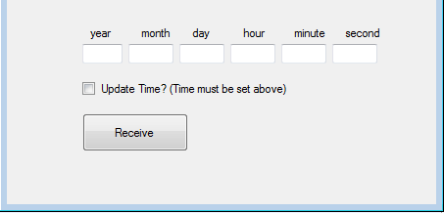
Programming (Jake)
Real Time Clock on processor
For timestamps, narrows online search
PC application to get data from device

Slide 19
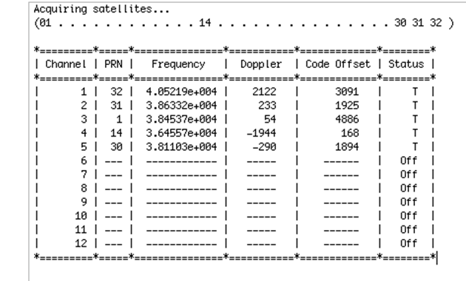
Post-processing (Eidy)
Adapt Matlab code to our project
Generate RINEX files from GPS data
Sample output from code

Slide 20
Results
Prototypes
Built and tested
Need to test connected system
Programming
In debugging phase
Processing
Reduced amount of data needed to 12s

Slide 21
Questions?

Slide 22
Embedded Programming
Hartman D. Rector

Slide 23
Embedded Software Design
The first time the system is powered on the flash memories are checked for bad blocks and that information is stored in nonvolatile memory.
The microcontroller then sets up the connections to the accelerometer and sets up interrupts that allow it to take a sample if movement is detected. Interrupts are also set up that cause a GPS sample to be taken upon a signal from the Sandia stack.
An interrupt is set up that allows transfer of the data stored in flash to a PC for processing.
The CPU then enters low power mode and waits for a signal to take a sample or transfer data to a PC.
Most of the work for this project involves interfacing the microcontroller with the various hardware components.

Slide 24
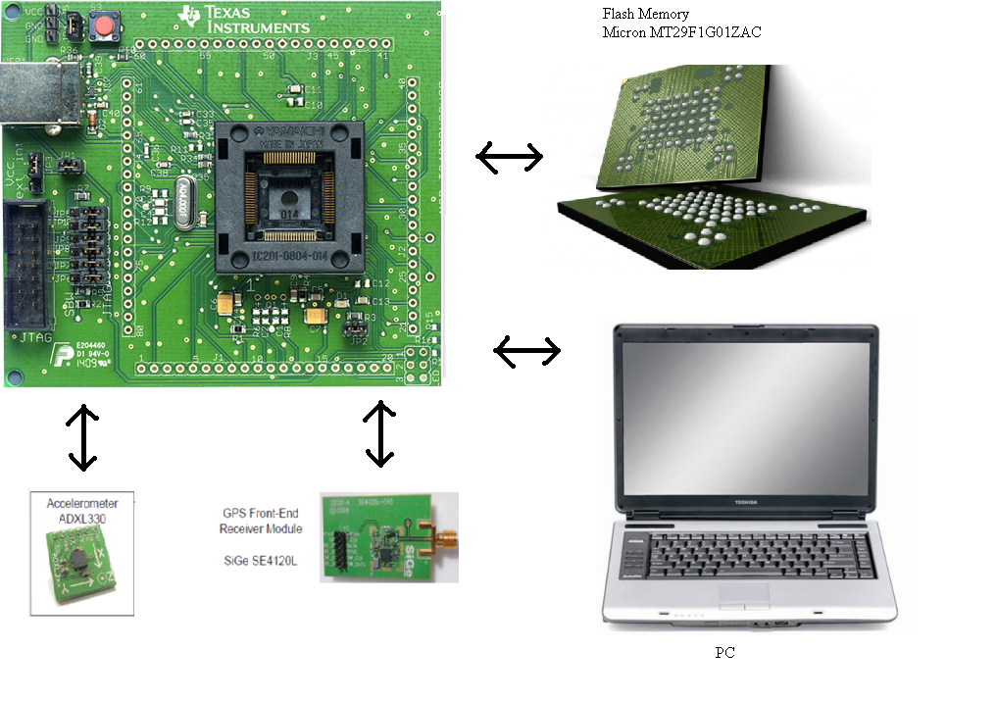
Interfacing

Slide 25
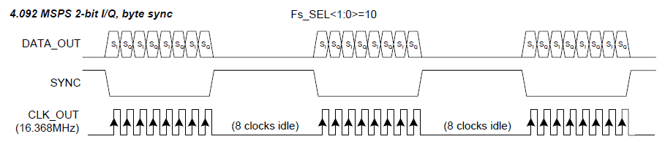
Interfacing With Flash Memory
Capture .2 to 15 seconds of uninterrupted data from GPS front-end, which has a speed of 16Mhz
Consume as little power as possible
GPS Front-End Output

Slide 26
Flash Memory Specs
Commands must be sent to the Flash memory to set up a write operation
A single page of data can be streamed directly into the flash memory at up to 50Mhz
A record command must be issued and the data must be flashed during which time data cannot be captured
The next write operation can begin

Slide 27
Design Decisions
To keep power consumption as low as possible the slowest possible microcontroller should be used.
To avoid interruptions in the data, two flash memories are used. Data is streamed into one while the other is flashed.
Each flash memory will have a multiplexer that will allow it to capture data and/or commands from ether the microcontroller or the GPS front-end
Because data is being captured from the front end directly custom software must be written to drive the flash memories

Slide 28
Old Flash memory
Original design flaws
Numonyx M25P128 flash memory
Page Size 256 bytes
Time to program page 2.5ms
Takes .3ms to shift data into flash
This leaves a 2.2 ms gap in data every .3ms
Matlab program requires 11ms of uninterrupted signal just to do acquisition

Slide 29
Our Memory Solution
Micron MT29F1G01ZAC 1Gb flash memories
page size = 2112 bytes
Time to fill page with data from SiGE: 2000us
Time to program page = 900us max.
This leaves 1100us to set up next write operation
Total memory size = 2Gb or 130 sec of data

Slide 30
Setup ports both muxes = MCU
.

Slide 31
.
Send reset and write commands

Slide 32
.
Switch mux flash 1 = front end

Slide 33
.
Wait for page to fill

Slide 34
.
Loop begins here

Slide 35
.
Toggle both muxes with xor

Slide 36
.
Write stop bit

Slide 37
.
Send program execute command

Slide 38
.
Wait for flash to program

Slide 39
.
Send write command

Slide 40
.
Wait for page to fill

Slide 41
.
Goto loop

Slide 42
.
Toggle both muxes with xor

Slide 43
.
Write stop bit

Slide 44
.
Send program execute command

Slide 45
Possible Flash Design Improvements
Microprocessor runs at 25Mhz to get the project up and running, this can be lowered when accurate timing information can be obtained.
Current design uses busy loop to wait for the flash to fill with data, this can be modified to put the CPU into low power mode while the data is being collected
Design could be optimized further by putting the command sequence in RAM and using the DMA to send the commands to the SPI. The CPU would be active only to write the record sequence into RAM.

Slide 46
Accelerometer
Our current design samples the accelerometer on startup to establish a threshold for movement.
When the threshold is exceeded the CPU is taken out of low power mode and a GPS sample is taken.
After the sample is taken the CPU goes back into low power mode.
ADXL335 Accelerometer

Slide 47
GPS Front-End
We are using the SiGe SE4120L GNSS Receiver
The receiver can be put into standby mode when it is not needed consuming less than 10u amps of current.
The output is streamed directly into flash memory for processing at a later time
With our current configuration the data is output as 2 bit I/Q. The sync line goes low and 8 bits of data are output followed by 8 idle cycles. This is convenient because it allows the microcontroller to wait for the sync to go high before recording a sample. As shown in the following code:
if(P2IN&BIT0) //if sync is high while(P2IN&BIT0); //wait for it to go low while(!(P2IN&BIT0)); //wait for it to go high P1OUT |= BIT4; //mux1 = sige

Slide 48
Questions?

Slide 49
Transferring GPS Data to a PC
Jacob J. Johns

Slide 50
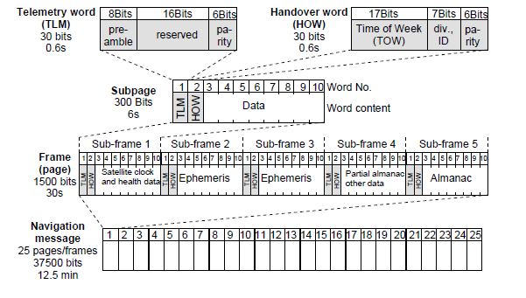
Real Time Clock (RTC)
Importance
Problems
Solution
Functions
Figure from: Essentials of Satellite Navigation GNSS Technology: page 31

Slide 51
Serial Communication
Why serial?
Design
Start byte (0x8C)
Send byte (0x10)
Acknowledge byte (0xA5)
Error byte (0x33)
Checksum (CRC8)

Slide 52
Serial Communication
User interface design for serial
The switch to USB

Slide 53
USB
Example code
Sets up virtual COM port to use with Hyperterminal
How it works
Select capture text in hyperterminal
Specify file to save to
Send GETDATA command in Hyperterminal
Select capture text -> stop in Hyperterminal

Slide 54
USB
Still working on
File format
Matlab
Post processing
User interface

Slide 55
Questions?

Slide 56
Processing GPS Data
Eidy C. Herrera

Slide 57
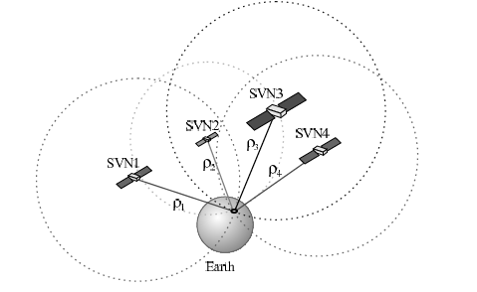
Post-Processing GPS Data
Four satellites required
Latitude
Longitude
Altitude
Time offset

Slide 58
Parameters Needed
Pseudoranges
Distance between the satellites and the receiver
Ephemeris data
Provides the satellites positions at any specific time

Slide 59
The Issue
Existing Matlab code
Need 37 s of GPS data (640 MB)
Lengthy tracking process (30 minutes)
Post-processing needs to be accomplished with a smaller sample

Slide 60
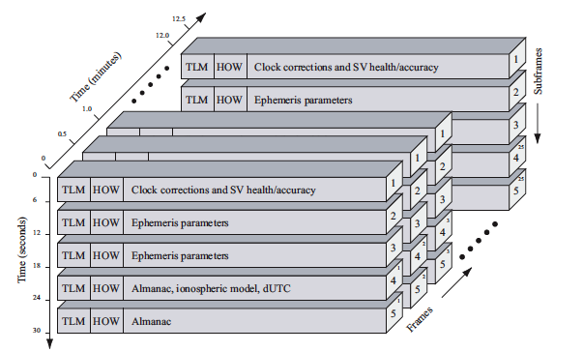
GPS Navigation Data Structure

Slide 61
Solution
New approach to process small data: integrating incomplete sample with stored GPS ephemerides
Using Matlab obtain
Pseudoranges
Time of the week
Acquire ephemeris data online
Combine records to get coordinates

Slide 62
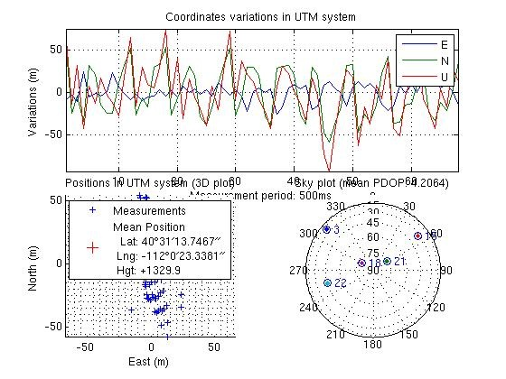
Verifying the Matlab code
Acquisition
Tracking
Position Solution
Notes:
The Matlab code does the acquisition, tracking, and position solution in the same program.

Slide 63
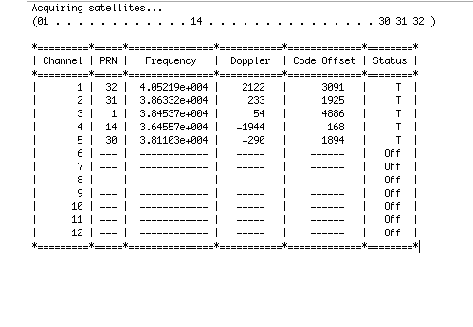
Using Matlab
Create a function to extract the desired length of data
Perform acquisition

Slide 64
Using Matlab
Reduce tracking time from 30 to 3 minutes
Omit ephemeris decoding
Compute valid pseudoranges
Travel time from the satellite to receiver multiplied by the speed of light
Obtain TOW

Slide 65
Creating a RINEX File
Pseudoranges & TOW
TOW UTC
105636 s = 29 hours 20 minutes & 36 s
Observations type
Using Text Editor
Strict format

Slide 66
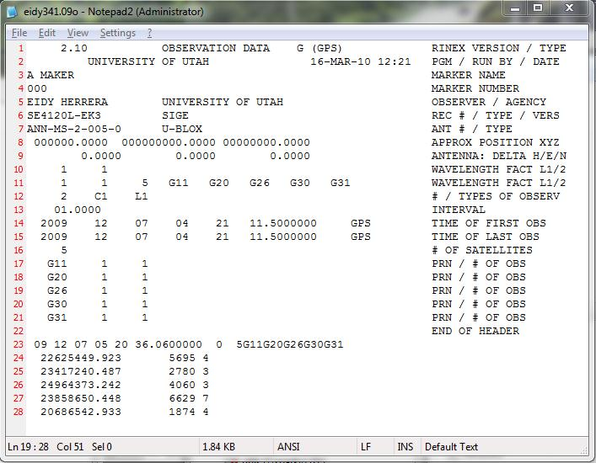
Creating a RINEX File

Slide 67
Obtaining Ephemeris Data
IGS (International GNSS Service) website
Find valid navigation RINEX file based on date and time of capture
File name format:
namedddh.yyn
2-digit year
letter for hour( a-x)
day of the year (1-366)

Slide 68
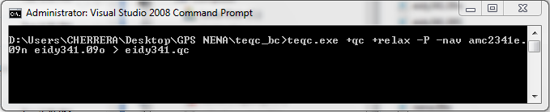
Obtaining Coordinates
Combine observable RINEX file created with navigation RINEX file found online
Teqc (toolkit for GPS data) by UNAVCO

Slide 69
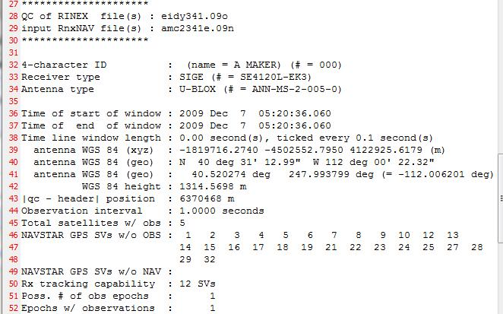
Obtaining Coordinates

Slide 70
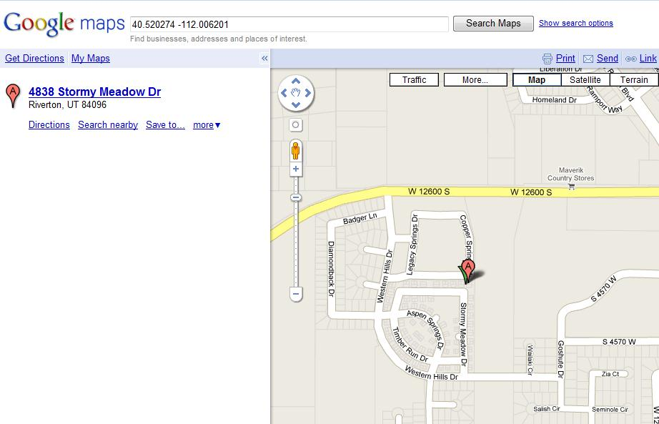
Mapping Coordinates
Google maps

Slide 71
Questions?

